Slide 1
Billing Processing

Slide 2
Lesson Objectives
Billing
Purpose
Use
Challenges
Billing Functions
Billing Processing
Interface to Finance Accounting
Billing Document Structure
Billing Method
Billing
Billing Types
Billing Type-Controls
Billing-Blocking Reasons
Billing Document-Create
Billing Document-Header Views
Notes:
Add instructor notes here.

Slide 3
Lesson Objectives
Billing Document-Item Views
Billing-Associated Functions
Copy Controls
Special Billing Process
Transaction Codes
Fiori Apps
Tips and Tricks
Additional Info
Notes:
Add instructor notes here.

Slide 4
Billing Process Overview

Slide 5
Billing Process Overview
A Billing Document is a commercial and legal document issued by a seller to a buyer, indicating quantities and agreed prices for products or services​
A billing document in most cases (except in cancellations and special cases) indicates that the payment is due by the buyer to the seller, according to the agreed terms. A Billing Document is represented in SAP as Billing type. Specific functions can be defined for each billing document type​
SAP provides many types of billing documents to cater to different business needs. Some examples are:​
Standard, Credit Memo, Debit Memo, Pro forma invoice for sales order, Pro forma invoice for delivery, Cancellation invoice etc.​
Sales Support
Sales Activity
Shipping
Delivery
Billing
Invoice | Debit Memo | Credit Memo
Sales
Inquiry | Quotation | Sales Order | Delivery Free of Charge | Subsequent Delivery Free of Charge | Returns | Scheduling Agreement | Contracts
Customer

Slide 6
Purpose
Invoices are transactions signifying a payment that your Customer owes you. The invoice may be attached to the goods when sent or forwarded separately
An invoice is a commercial document issued by a seller to a buyer, indicating the products, quantities and agreed prices for products or services with which the seller has already provided the buyer
An invoice indicates that, unless paid in advance, payment is due by the buyer to the seller, according to the agreed terms
Invoices are often called bills
The preparation of Bills can be referred as the Billing process

Slide 7

Use
Invoice is a legal document authenticating the transaction hence can be used as a reference for all payment relevant correspondences
Useful for working out the sales statistics, profit and loss on buying price and selling price
Invoices are the proof sale hence can give details on taxes

Slide 8
Challenges
To maintain the correctness in terms of:
Prices
Taxes
Terms of Payment
Billing intervals
Including Down Payments
Reporting
Cancellation

Slide 9




Billing Functions
The following functions are supported by billing:
Creation of invoices(and pro-forma invoices) on the basis of deliveries & services
Transferring posting data to financial accounting
Creation of credit and debit memos on the basis of requests
Cancelling business transactions
1
Order
2
Order
3A
Credit Memo
Request
3B
Debit Memo
Request
Delivery
4
Invoice
Invoice
Credit
Memo
Debit
Memo
^{In}_{X}^{voice}
Cancellatio
Document
Cancellation
100.00
100.00
15.00
15.00
15.00
15.00
15.00
15.00
100.00
100.00

Slide 10

Billing Processing
There are different ways to create a billing document by:
specifying the documents (Sales order or Delivery) to be billed
processing manually from the billing due list
having the system process a billing due list automatically as a background task
Also the following methods may be used for creation of an invoice :
Delivery Invoice
✶ Separate Invoice for ^{Sales}
Each Delivery Delivery Invoice
Order
Invoice
Sales
Invoice
Order
Deliver
✴
Invoice
Split
Delivery
^{Sales} Delivery
→ Collective Invoice ^{Delivery Invoice}
^{Sales} Delivery
Order
Order

Slide 11








Interface to Financial Accounting
During billing, the data relevant for accounting is passed on to financial accounting and posted to the corresponding accounts.
These accounts are determined automatically on the basis of the account determination criteria in the billing document.
Billing
Document
Customer
Pays:
$114
Receivables
114
Revenue
100
Tax
14

Slide 12









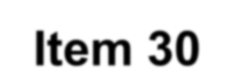
Billing Document Structure
Valid for Entire Document:
Identification number of Payer
Billing Date
Net Value of entire Billing Document
Terms of Payment and Inco terms
Pricing Elements
Document Currency
Header Data
I
tem
Valid for Each Item:
Material number
Billing Quantity
Pricing for an individual item
Weight and Volume
Number of reference document for billing document
tem
10
I
tem
tem
20
Item 30

Slide 13
Billing Method

Slide 14
Billing Methods
Creating an individual billing document for every sales document
Billing one or more SD documents with several billing documents (this is called an invoice split)
Combining several SD documents into a collective billing document
1. Individual Billing
Delivery
Invoice
Sales order
3. Collective Billing
Delivery
Invoice
Sales order
Delivery
Delivery
Invoice
2. Invoice Split
Invoice
Sales order
Delivery
Sales order
Delivery
Invoice

Slide 15
Billing Methods - Individual Billing Documents
SAP can set the system to create one billing document for each sales document, e.g. one invoice per delivery

Slide 16
Billing Methods – Invoice Splits
If you want to guarantee that invoices are created separately according to certain criteria, you can do this by defining certain split criteria
As a rule, the system combines into one billing document all transactions for the same customer, default billing date and sales organization. If data from the related reference documents differs in the header fields of the billing document, the system will automatically split the invoice
An order contains terms of payment at header as well as item level. These are stored only at header level in the billing document, however. If there are different terms of payment in the reference documents, an invoice split will always be made
The system does not split the invoice. If you require an invoice split, you must first define the appropriate split in customizing. You can also display a split analysis to discover why an invoice split has occurred
Invoice
Sales order
Delivery
Invoice

Slide 17
Billing Methods – Collective Billing
As long as certain data agrees, you can also combine different documents (orders and/or deliveries) fully or partially in a common billing document.
The following prerequisites must be met:
The header data appearing in the billing document must agree
The split conditions specified do not apply
Sales order
Delivery
Delivery
Invoice
Sales order
Delivery

Slide 18
Billing

Slide 19
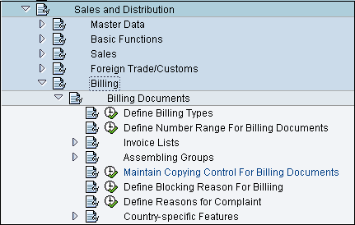
Billing
You can create new
billing types or redefine
Define Number
ranges
Displaying
List
Maintain Copy
Control
Define Blocking
Reasons
Menu Path
For configuration:
IMG – Sales and Distribution
– Billing – Billing Documents

Slide 20


Billing Types
Number
Range
Output
Procedure
Partner
Procedure
F2
Cancellation
Billing Type
Account
Determination
Procedure
Billing
Type
F5
G2
L2
BV
Invoice List
Type
Posting
Block?
Relevant
for
Rebate?

Slide 21
Billing Types
F1 - Order related Invoice :
1. If you want to receive money before you
send the goods to the customer,
then create an invoice with reference to a sales order.
2. Commonly used billing documents would be
Credit memos
Debit memos
Invoice correction request
F2 - Delivery related invoice :
1. If you want to make sure that the goods are sent out before the invoice is created, then create an invoice on the basis of the delivery.
2. You can create an invoice either with reference to order or delivery.

Slide 22
Billing Types
IV - Inter company Sales :
1.Transaction occurs when selling organization belongs to different company code than delivering plant.
2. It differs from standard billing type in following manner.
Customer number is treated as ‘Internal customer’. Assignment of order type to inter company billing type IV.
Material to be sold should be exist in receiving and supplying plant.
Copy control for ‘F2’ to ‘IV’.
Pricing procedure have special condition type ‘IV01‘.
S1 - Cancellation Invoice :
cancellation and offsets accounting entry.
billing type control of ‘F2’(billing document type) .
1.System copies data from reference document into
2.You can maintain cancellation document type in
3.You can cancel individual items in billing document.
BV –Cash Sale :
2. Following details will differ from standard
a. Order-related billing
sales document)
c. No new price determination (pricing not differed from printed invoice)
d. Posting in FI made to cash settlement not to customer
e. Billing type ‘SV’ is used for cancellation.
G2/ L2 - Credit / Debit memo :
1.You can create w.r.t. credit / debit
memo request or with reference to billing.
2. System set a billing block automatically.
3. Thus employee can
release request and decide the amount or quantity to be credited or debited.
reject the item and mention reason of rejection.
1. Order and Delivery created in one step.
billing type.
b. No output determination (carried out in

Slide 23
Billing Types
F8 - Pro forma Invoice :
1.Mainly it is used for ‘Export transaction’.
2.It is used for information purpose only.
3.You can create as many as pro forma invoices.
4.Data is not transferred to Accounting.
5.Copy control parameter “ Quantity/Value Pos./Neg.“
is not available for entry in order to avoid possibility of updating the quantity that has
been billed.
RE – Credit for Returns :
1.You can create a return for goods sent back from customer.
2.Returns are processed in the same way as
a credit memo request.
3. Credit memo is billed with reference to order and not the return delivery.
Invoice Correction Request :
1.It is combination of credit and debit memos.
2.Items are automatically duplicated and resulting item categories must pos / neg values.
3.You can create memo for price or
quantity difference.
4.It must be created with reference to corresponding billing document (not order or output)
©India SAP CoE, Slide 18

Slide 24
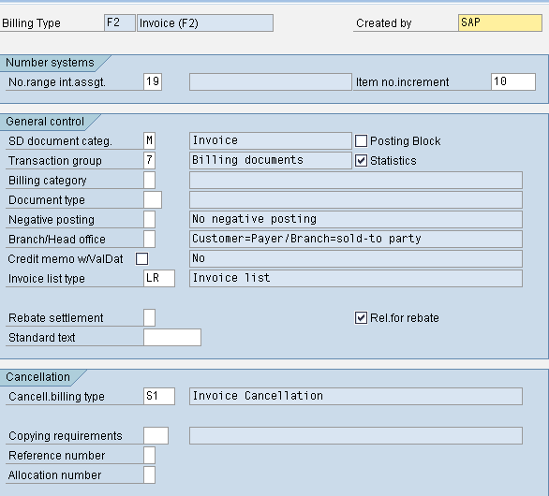
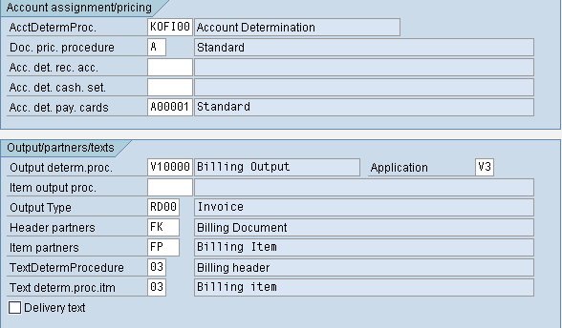
Billing Type-Controls
Used for propose which
G/L accounts entries must
^{Only internal} If activated , automatic t
is possible not possible
Update
LIS
What type of document system is using?
System automatically uses this billing type
Selection of cancellation billing type will depend on ‘copying requirement also’.
be posted.
Used for pricing determination with sales area.
Used to determine output type
number range
posting to accounting is
The billing type controls whether the creation of a billing document will automatically post entries to accounting
IMG – Sales and Distribution – Billing – Billing Documents – Define billing types

Slide 25
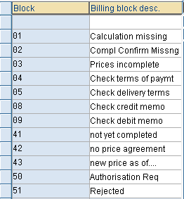
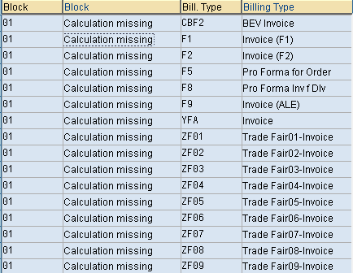
Billing – Blocking Reasons
A factor that blocks document processing of documents.
Define blocking
reason
Assign
blocking
reasons
for
Billing Types
Menu Path for configuration:
IMG – Sales and Distribution – Billing – Billing Documents – Define blocking reasons for billing

Slide 26
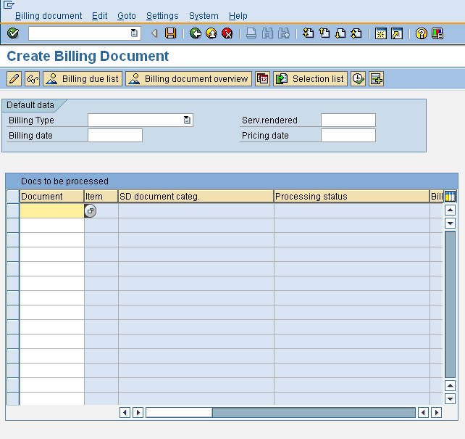
Billing Document-Create
Enter reference document number or select from the list
SAP Easy Access – Sales and Distribution – Billing – Billing Documents-Create
Transaction Code : VF01

Slide 27
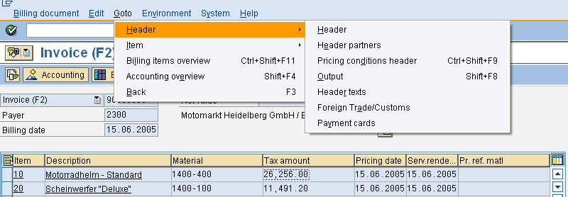
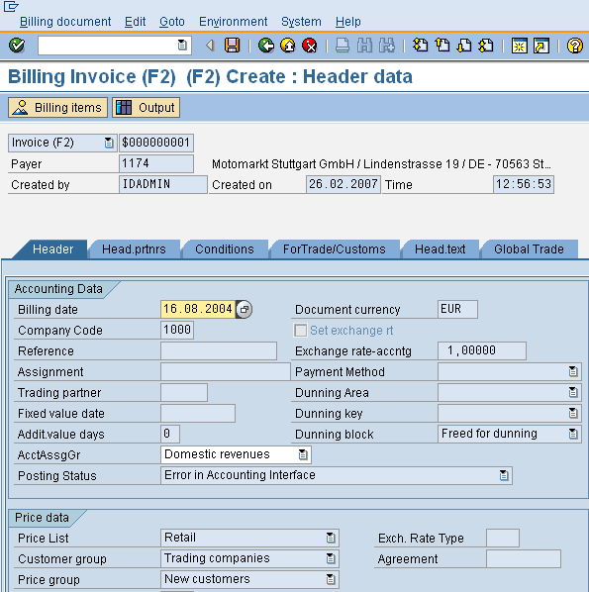
Billing Document-Header Views
VF01 – Create Billing

Slide 28
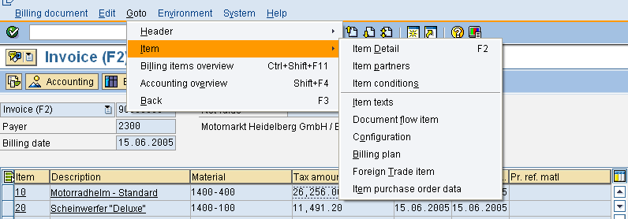
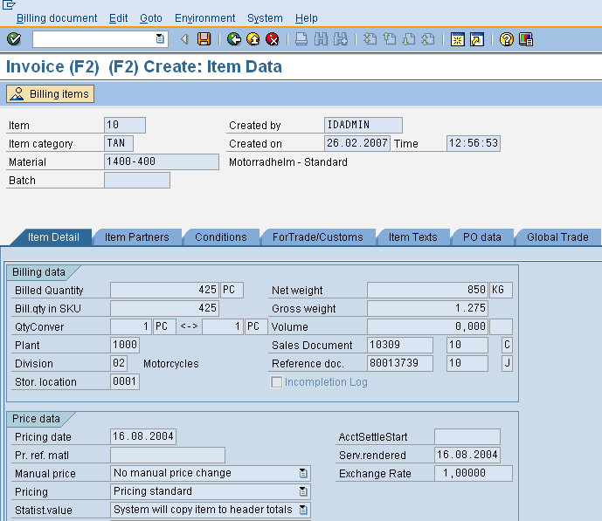
Billing Document-Item Views
VF01 – Create Billing

Slide 29
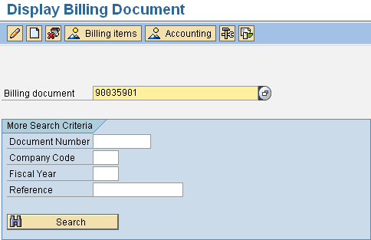
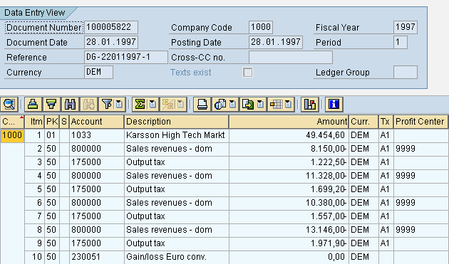
Billing-Associated Functions
To view accounting document, click on ‘Accounting ’
Accounting Document
Details

Slide 30
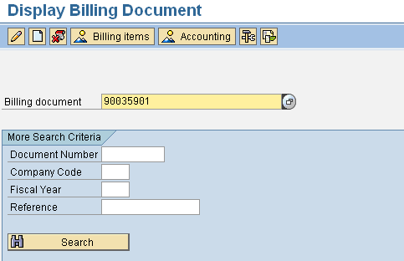
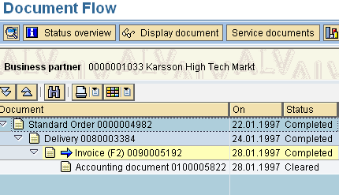
Billing-Associated Functions
Display
Document flow
To keep track of Document, click on ‘Display Document Flow’
It is very easy to find all related preceding & subsequent documents with ‘document flow’ function. You can also view individual document.

Slide 31
Copy Controls
How does data gets transferred?
Target Billing type Source Del. type
Header _{F2 LF}
1) Which documents may be used as a reference for billing?
2) Determination of :
Foreign Trade data
Allocation Numbers
Reference Numbers
Item Numbers
Target Billing type Source Del. type Source Item Cat.
Item F2 LF TAN
1) Which quantity should be invoiced (order or delivery quantity) ?
2) Pricing and exchange rate ?
3) Updating quantity and value in referencing document
4) Should pricing be carried out again or should prices be copied from sales order?

Slide 32
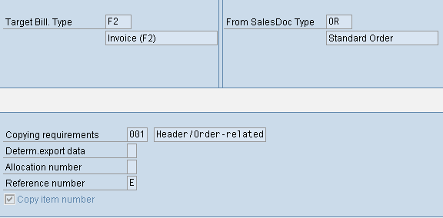
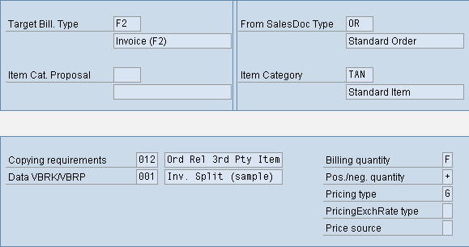
Copy Controls
HEADER
Which documents
to be used as a
basis for billing?
How sales document is to be billed w.r.t. requirement? e.g. whether goods is to be issued before billing.
In what manner item
should behave ? e.g. is it price relevant?
ITEM
How much quantity is to be billed? e.g. order quantity or delivery.
Should pricing to
Copy control :
Billing Document
Billing Document
be carried out
again or to be copied from Sales order?
Document (OR) e.g. Sale of Service
(F2) to Sales
(F2) to Delivery Document (LF) e.g. Sale of Goods

Slide 33
Special Billing Process

Slide 34
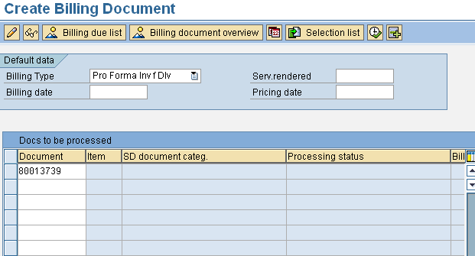
Special Billing Process
Select document type
Enter document number
Pro forma Invoice
You can use following billing types
F5 – Sales Order
F8 – Delivery
It differs from invoices in following way : Goods Issue is not required in delivery related pro forma invoice.
You can create as many invoices as billing status is not updated.
Data from Pro forma is not passed to FI accounting
Transaction Code : VF01

Slide 35
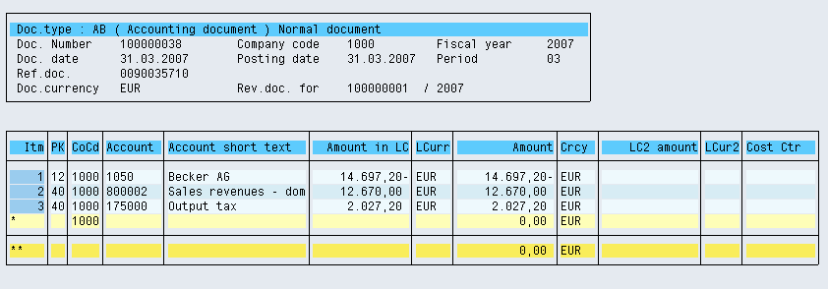
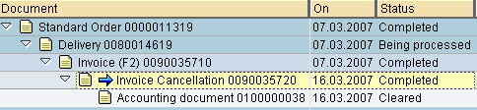
Special Billing Process
Cancellation of an Invoice
Transaction Code : VF11 (SAP Easy Access → Sales and Distribution→Billing→Billing Documents →Cancel
You can select invoice by putting the invoice number or you can select from the list
The effect in accounting document after cancellation
Document Flow

Slide 36
Transaction Codes
How
to
do
configuration
Settings
???
VOFA
Define Billing Types
VN01
Define Number Range for Billing Document
VTFA
Copying control: Sales Document to Billing
Document
VTFF
Copying control: Billing Document to Billing
Document
VTFL
Copying control: Delivery Document to Billing
Document
SPRO
Define and assign Blocking Reasons
SPRO
Define Internal Customer number by sales organization (for Intercompany Billing)

Slide 37
Transaction Codes
How
to
proceed
with
the
TCODE
in
billing
???
VF01
VF02
VF03
Create Billing Document
Change Billing Document
Display Billing Document
VF11
Cancel Invoice
VF04
Process Billing Due List
VFX3
Blocked Billing Document
VF21
VF22
VF23
Create invoice list
Change invoice list
Display invoice list
VF26
Cancel / Reverse

Slide 38
Fiori Apps :
Create Billing Document
Cancel Billing Document
Some Important Fiori Apps

Slide 39
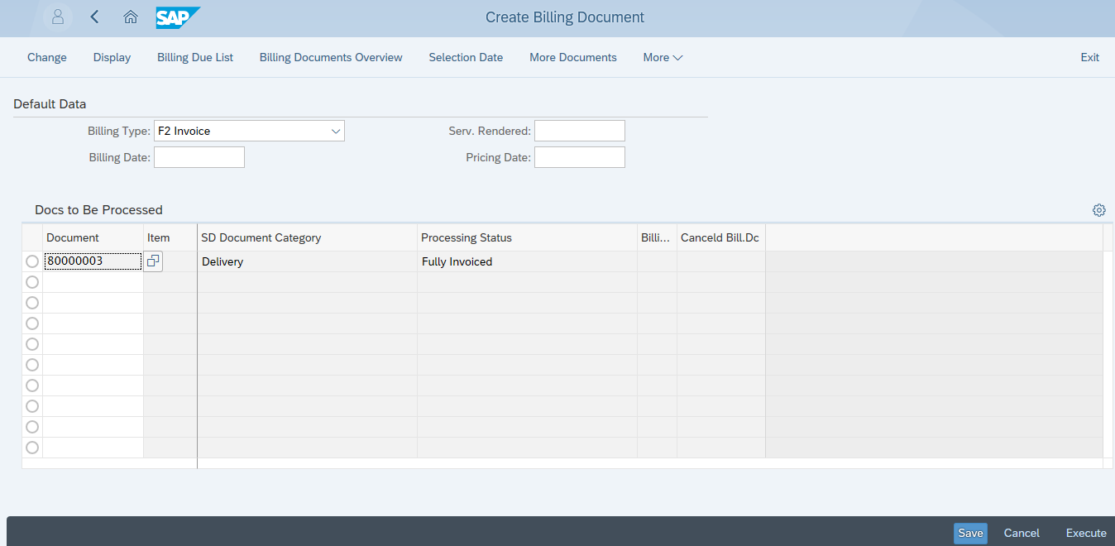
Create Billing Document
1. Choose Billing Type
2. Enter Delivery Number
3. Click on Execute

Slide 40
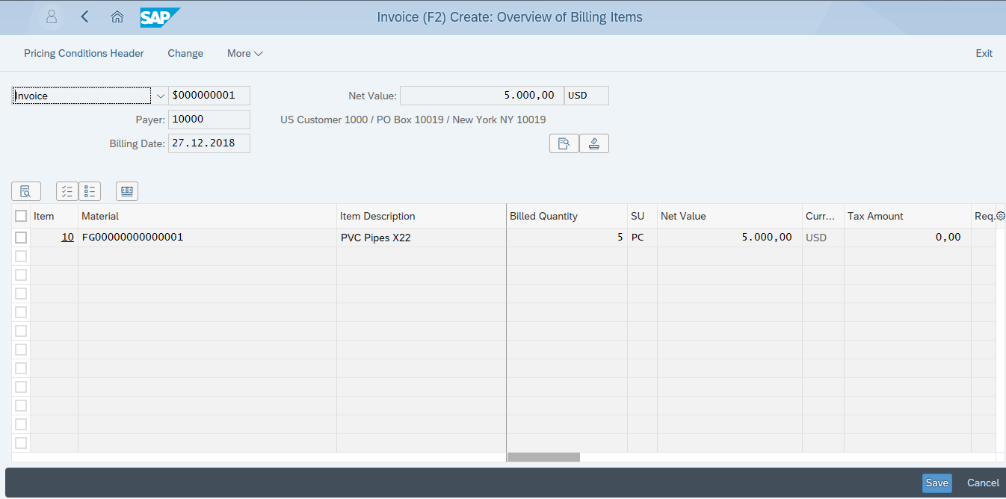
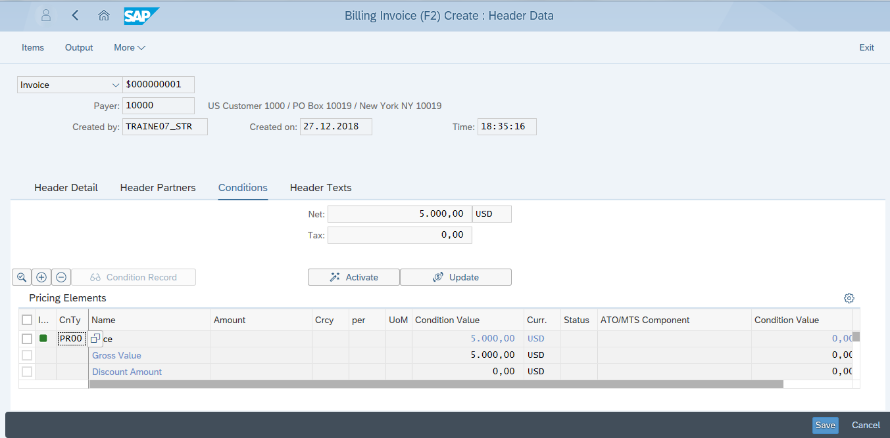
Create Billing Document
Save

Slide 41
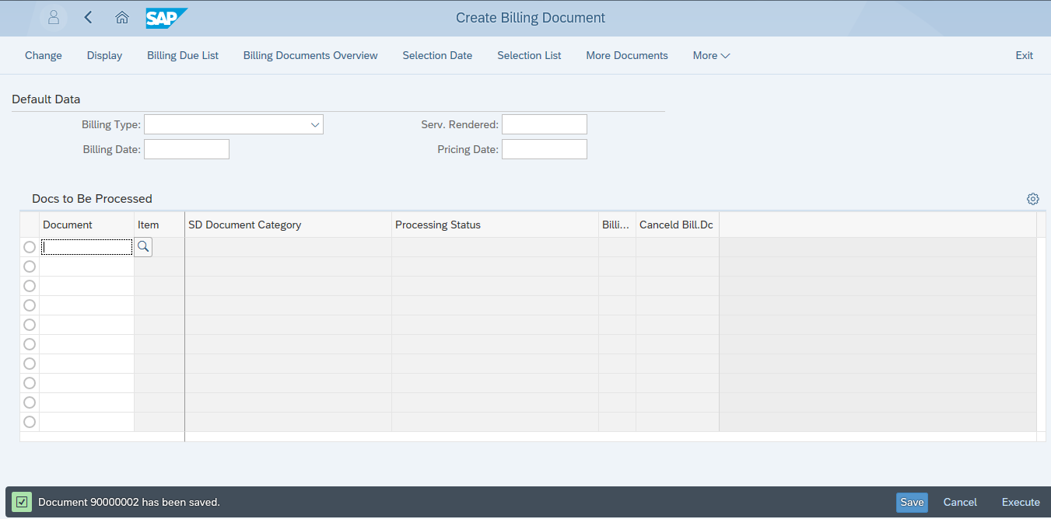
Create Billing Document
Billing Document Saved

Slide 42
Fiori Apps :
Create Billing Document
Cancel Billing Document
Some Important Fiori apps

Slide 43
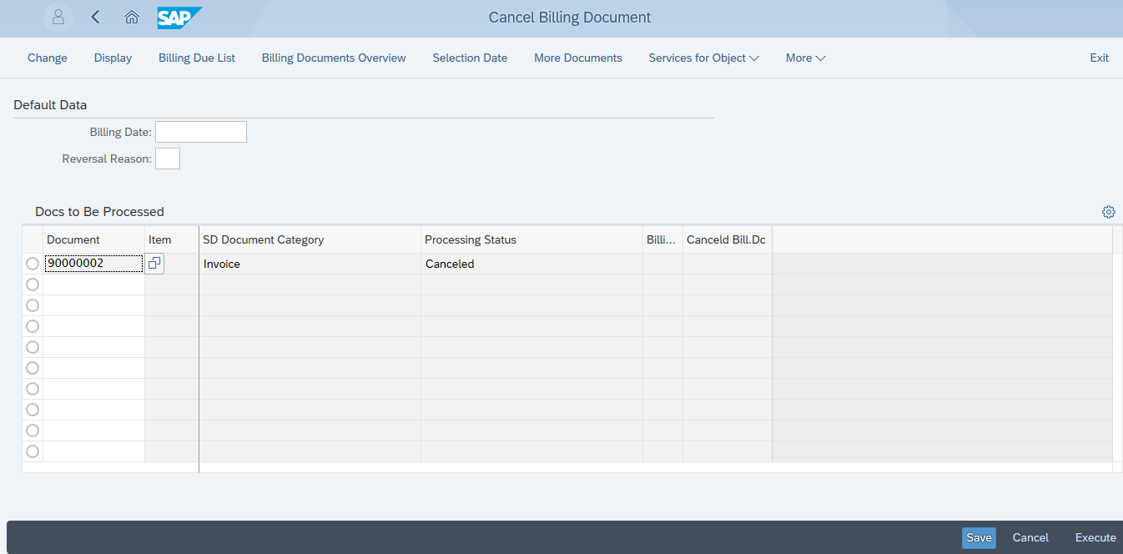
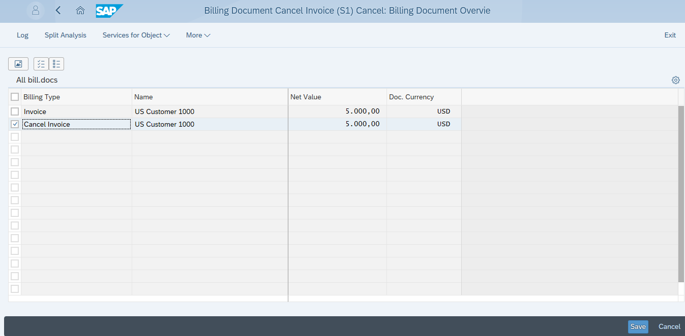
Cancel Billing Document
1.Enter Billing Document Number
2.Execute
3.Select
4.Save

Slide 44
Tips and Tricks
You can create invoices using background job
You can run background job automatically as follows:
At a specific time
Periodically
You can edit log by viewing ‘Change Billing Document’.
Billing Document type is determined automatically , hence no need to select in ‘Create Billing Document’ Screen
You can create
Split Invoices(If Bill To Party is different)
Collective (if Bill to party is same or you want to combine items from one or more delivery)

Slide 45
Tips and Tricks
You can create invoice lists
For invoice and debit memos
For credit memos
Use VFX3 transaction for collective release of blocked documents to accounting
You can select options for the billing documents which may be incomplete due to pricing error, Foreign Trade data and error in authorization

Slide 46
Tips and Tricks
When you create billing document, system forwards related data to Accounting. To post data to appropriate General Ledger account, system uses ‘ Account determination technique.’
Following are the checkpoints to generate accounting document without any errors :
In customer master, Account assignment group of customer has to be maintained
In material master, Account assignment group of material has to be maintained
In sales order header data, pricing procedure has to be checked

Slide 47
Tips and Tricks
System uses following G/L accounts : Customer account receivable General Ledger
Revenue
Sales Deductions
Accruals
Make sure that FI can recognize all billing documents belonging to one business transaction (e.g. credit memo to invoice). This can be done by customizing reference number and allocation number
Transferring partner functions to Accounting : You can use this indicator to determine which partner function (Payer) should be transferred to accounting when billing type maintained

Slide 48
Tips and Tricks
You can determine FI document type from billing type. If not maintained, system automatically determines document type ‘ RV ‘.

Slide 49
Additional Info
Following are the tables used related to Billing :
VBRK: Billing Document Header Data
VBRP: Billing Document Item Data
VBFA: Sales Document Flow
You can restrict to maximum number of items to be printed on invoice within a given sales organization (by maintaining country specific features)

